Slide 1

SPRING 2020 - EM 622 - DECISION MAKING VIA
DATA ANALYSIS.
INSTRUCTOR : ASSISTANT PROFESSOR SANG-WON BAE
TEACHING ASSISTANT : HARSH JAIN

Slide 2
RESTAURANT PREDICTION SYSTEM USING R ANALYSIS
PROJECT BY: TEAM SHARKS
PROJECT MEMBERS: NEHA PATADE
MONIL SHAH
SUSHANT GHORPADE
SWARAJ KATE
NIRAJ CHAUHAN
SUSHANT GHATYADAK

Slide 3
GOAL :
Our objective is to predict and make decision based on Data Analysis and Visualization for a client who wants to invest in food and beverage industry.
STORY :
Our client is an Indian based investor from Bangalore (City in India) who wants to invest in restaurant industry.
He is not sure whether he wants to set up a restaurant, cafe, Dine and wine etc.
Based on the data from ZOMATO (An Indian food delivery app) our team is going to help him make decision on where and what type of set up should he go for depending on multiple variables through the dataset

Slide 4
DATASET RESOURCE: https://www.kaggle.com/himanshupoddar/zomato-bangalore-restaurants
DATASET VARIABLES:
•URL – Contains URL of restaurant on Zomato website
•Address – Contains address of restaurant in Bengaluru
•Name – Contains name of the restaurant
•Online_order – Online orders taking place
•Book_table – Number of table bookings
•Rate - Contains overall rating of restaurant on scale of 5
•Votes - Contains total number of rating for the restaurant as of the above mentioned date
•Phone - Contains the phone number of the restaurant
•Location - contains the neighborhood in which the restaurant is located
•Rest_type - Restaurant type
•Dish_liked - Dishes people liked in the restaurant
•Cuisine - Food styles, separated by comma
•approx_cost(for two people) - Contains the approximate cost for meal for two people
•reviews_list - List of tuples containing reviews for the restaurant, each tuple consists of two values, rating and review by the customer
•Menu_list - contains list of menus available in the restaurant
•listed_in(city) - contains the neighborhood in which the restaurant is listed
•listed_in(type) - Type of meal

Slide 5
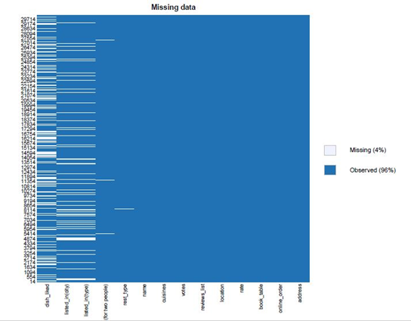
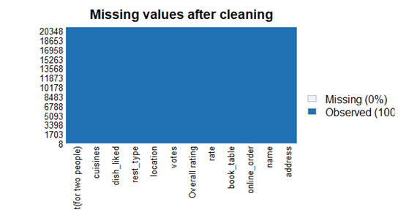
DATA CLEANING
In order to clean the dataset we initially checked the structure and the summary of our dataset and with the help of summary, we imputed the missing values of the similar columns with the mean.

Slide 6
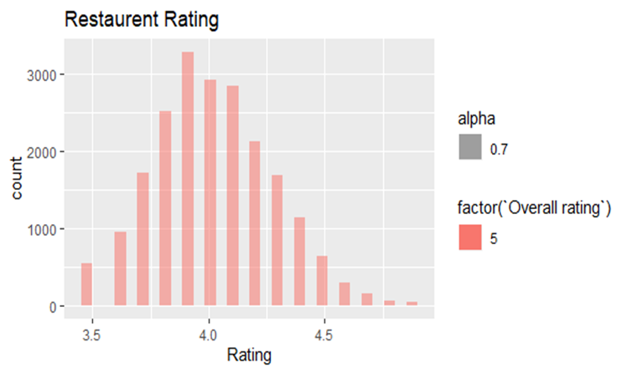
RESTAURANT RATING
•The bar graph on the left represents the overall rating vs the frequency of restaurants rating.
•It can be observed that the graph follows a pattern similar to normal distribution.
•It can be seen that the max count of ratings ranges between 3.8 to 4.0
•Also we can see the count decreases as the ratings move towards 5.0
Bar graph of Overall rating vs Frequency of Restaurants rating

Slide 7
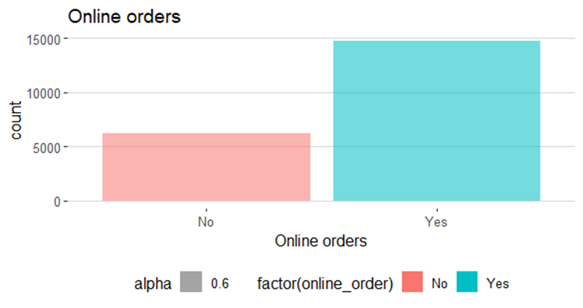
ONLINE ORDER COUNT PLOT
•As we can observe maximum restaurants provide online order and take away as compared to table reservations and dine –in.
•This indicates that people these days prefer to order food online than to go out and dine-in.
•It can also be assumed that the majority crowd consists of bachelors, students\ working.
Bar graph of count of Online orders

Slide 8
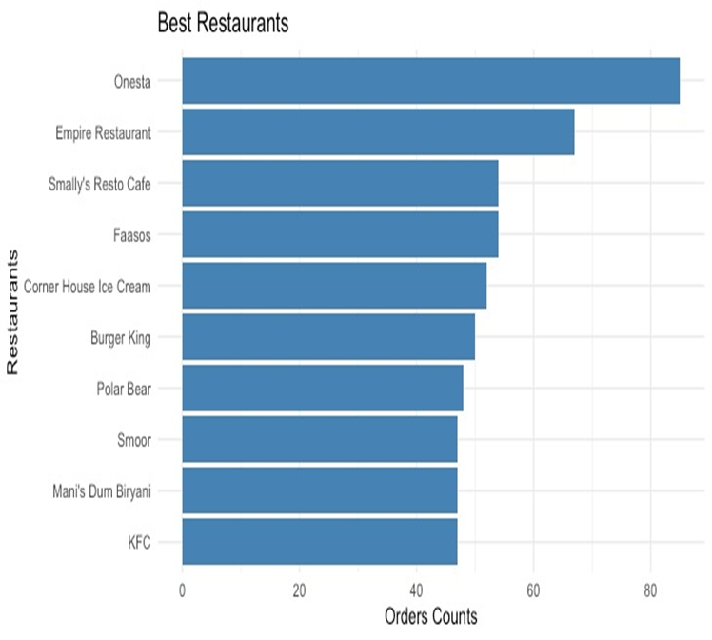
TOP 10 BEST RESTAURANTS IN BANGALORE
●The plot on the left indicates the bar graph of the top 10 best restaurants in Bangalore.
●This plot is provided on the basis of order counts.
● barplot() function was used to plot this graph
●Using this data, client can understand which type of restaurant has maximum sales.
●This plot will help our client to have knowledge about the competition he will face when he will set up his restaurant and have an idea of which restaurant to open.
Bar graph of top 10 best restaurants in Bangalore

Slide 9
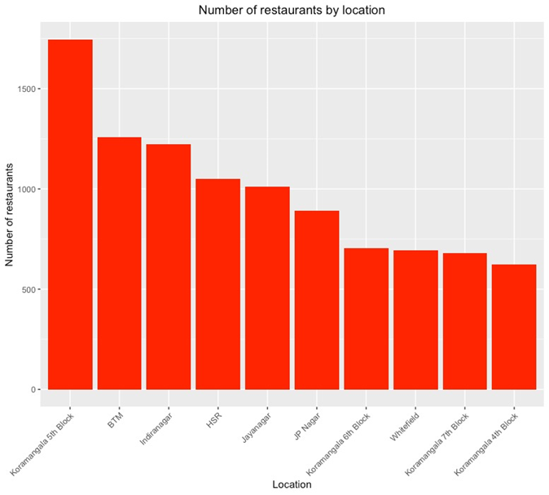
TOP 10 LOCATIONS FOR RESTAURANTS IN BANGALORE
●Provided plot describes about the number of order to restaurants by top 10 locations in Bangalore.
●This plot could recommend our client to select a specific location, depending on the competition and the area in which our restaurant could acquire maximum profit and have more customers.
Bar graph of top 10 locations for restaurants in Bangalore

Slide 10
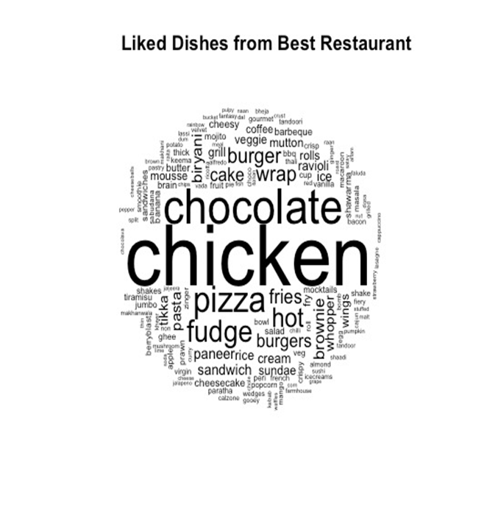
DISHES LIKED FROM BEST RESTAURANT
●This wordcloud is extracted from column “Dishes liked” by the customers who visited the restaurant by using wordcloud() function.
●Provided plot on the left is a wordcloud of all the liked dishes from the 10 best restaurants mentioned in the plot above.
●As seen from the word cloud: Chicken, chocolate, burger, pizza etc are the most liked dishes.
●On the basis of this wordcloud plot, we can recommend our client to put this dishes on the restaurant’s menu list.
WordCloud of Liked dishes from Restaurants

Slide 11
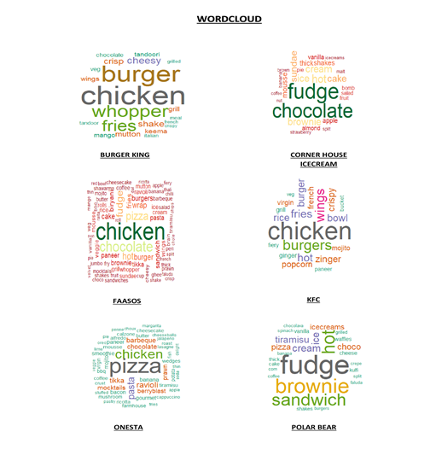
MOSTLY LIKED DISHES FROM BEST RESTAURANT
We have extracted individual wordcloud for the top 10 restaurants of the dataset.
We have made use of libraries such as dplyr, tm, and wordcloud.
Initially we filtered out our dataset into a new cleaned dataset which provided a list of top 10 restaurants of the dataset.
Then we builded corpus and made use of tm library for text cleaning and analysis.
During this text cleaning, we made sure that we removed all the punctuations, numbers, stopwords (and, or, the, was, for etc), and whitespace.
Individual WordCloud for top 10 Restaurants

Slide 12
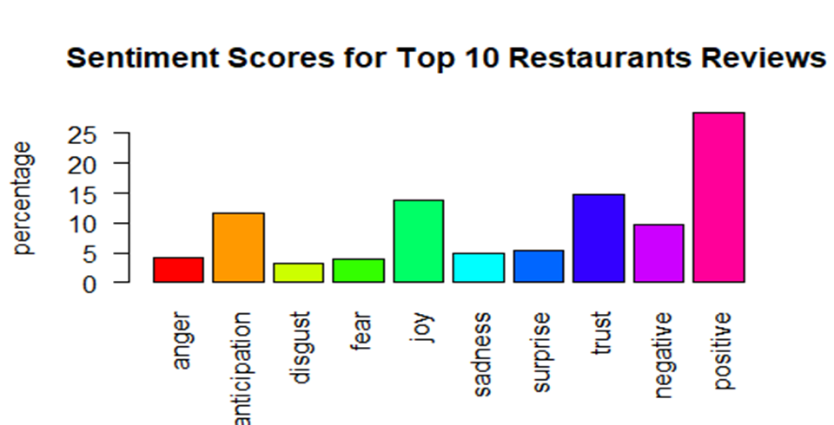
CUSTOMER REVIEW ANALYSIS
●Using this sentiment analysis we can successfully quantify the sentiments of each customer
●To calculate sentiments or opinions for each review we have used the function get_nrc_sentiments()
●Using this information we can help our client decide which restaurant should they pursue and which food/ restaurant is likely to be successful.
Sentiment Analysis of reviews of top 10 restaurants

Slide 13
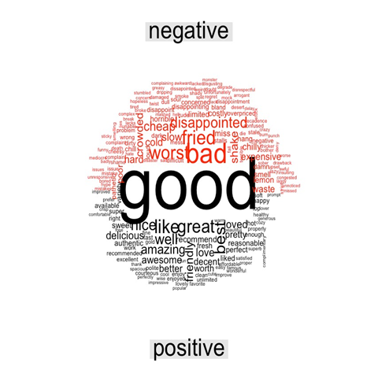
REVIEWS OF TOP 10 RESTAURANTS
This word cloud represents the words that are used in the reviews and are classified as positive and negative and are represented by the colour i.e. red for negative and black for positive words
This word cloud infers us about the customers reviews and helps us to understand the customers sentiments for the food and restaurant.
Word Cloud of positive and negative words used by customers in their reviews

Slide 14
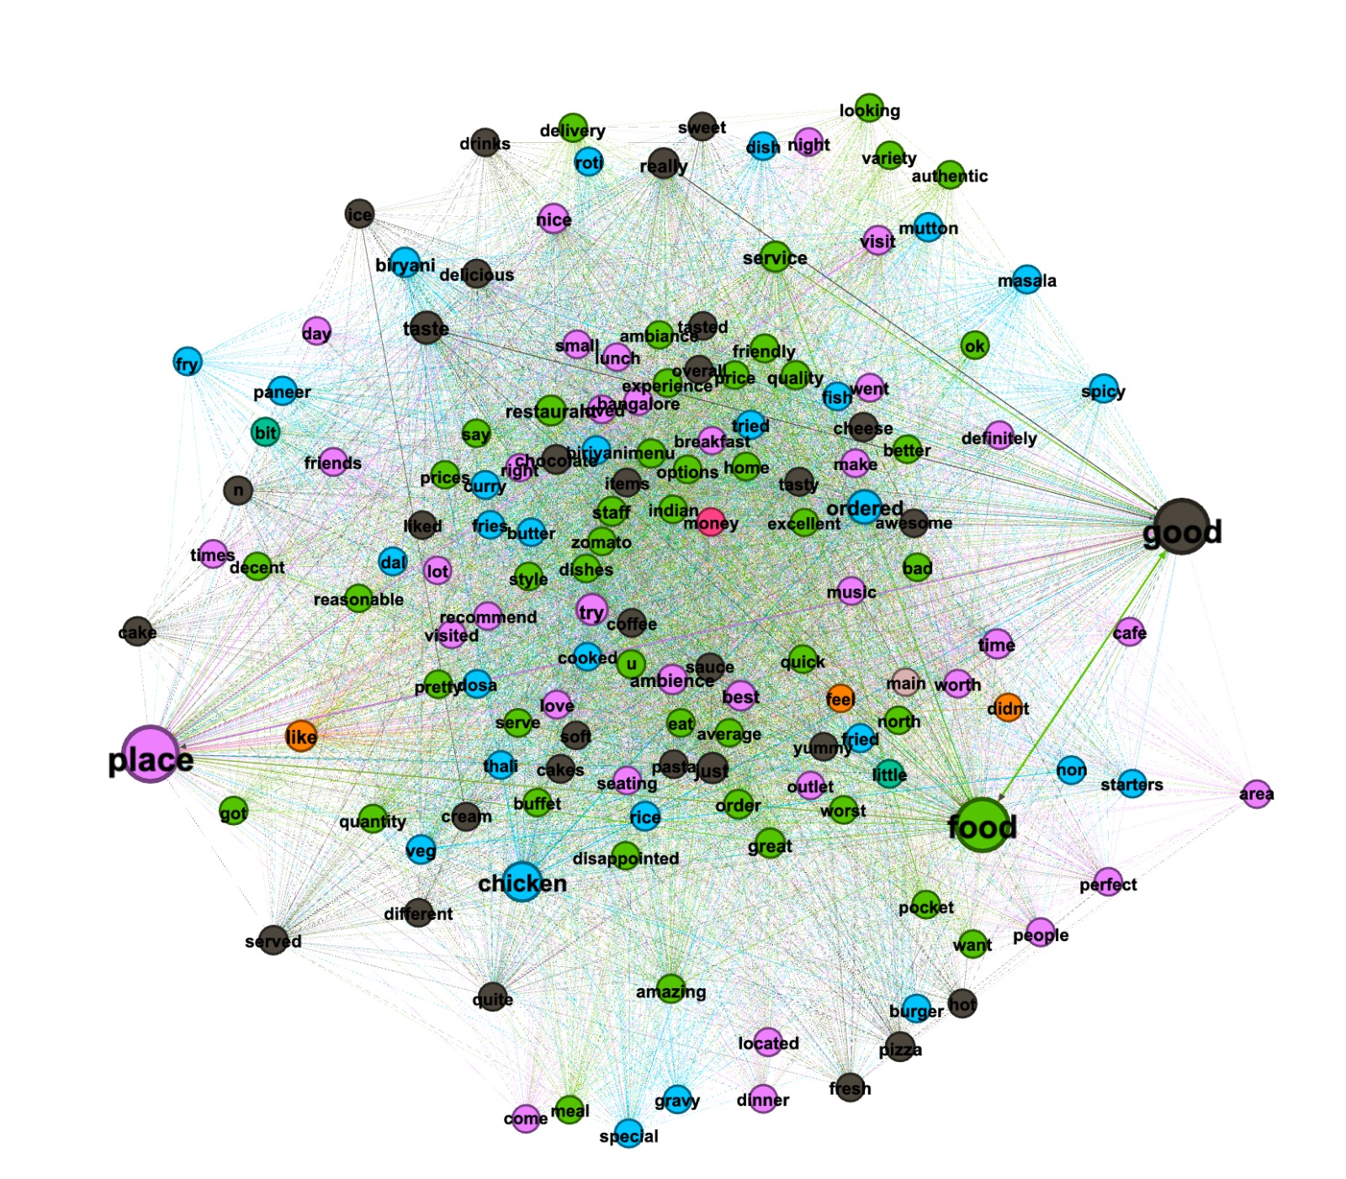
TRENDING TOPICS
To perform network analysis we have used Gephi software to plot the neural network.
Here we are using column reviews to see the clusters of words coming together.
By implementing this we can understand that there are 3 main hot topics between people i.e. Food, Good, Place.

Slide 15
ANIMATED AND INTERACTIVE GRAPHS
Libraries such as Ggplot, plotly, animate and transition were used to generate this Interactive Graphs.
Here we can see the rating of our top 10 restaurants.

Slide 16
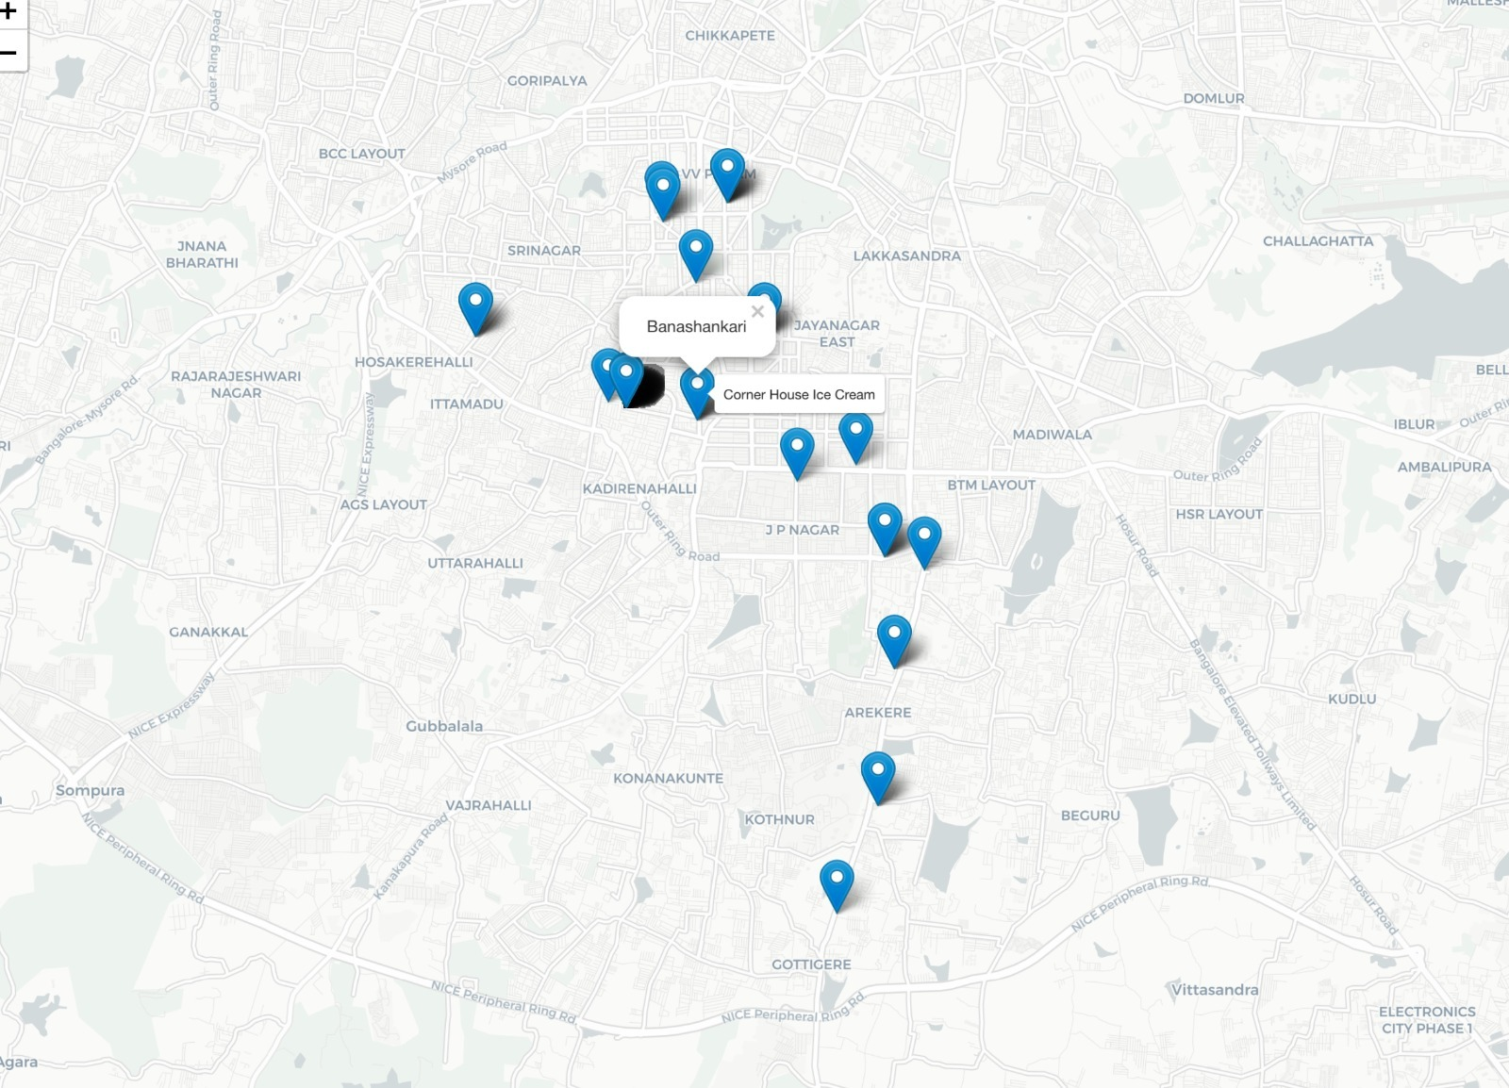
LOCATION OF RESTAURANTS
This plot infers us about the geographical locations of the most likely Top 10 restaurants.
We used Google Application Programming Interface (API) to extract latitude and longitude from all the address from top 10 restaurants.
While we hover on marker, it gives us location name and we press on the marker, it provides us restaurant names.

Slide 17
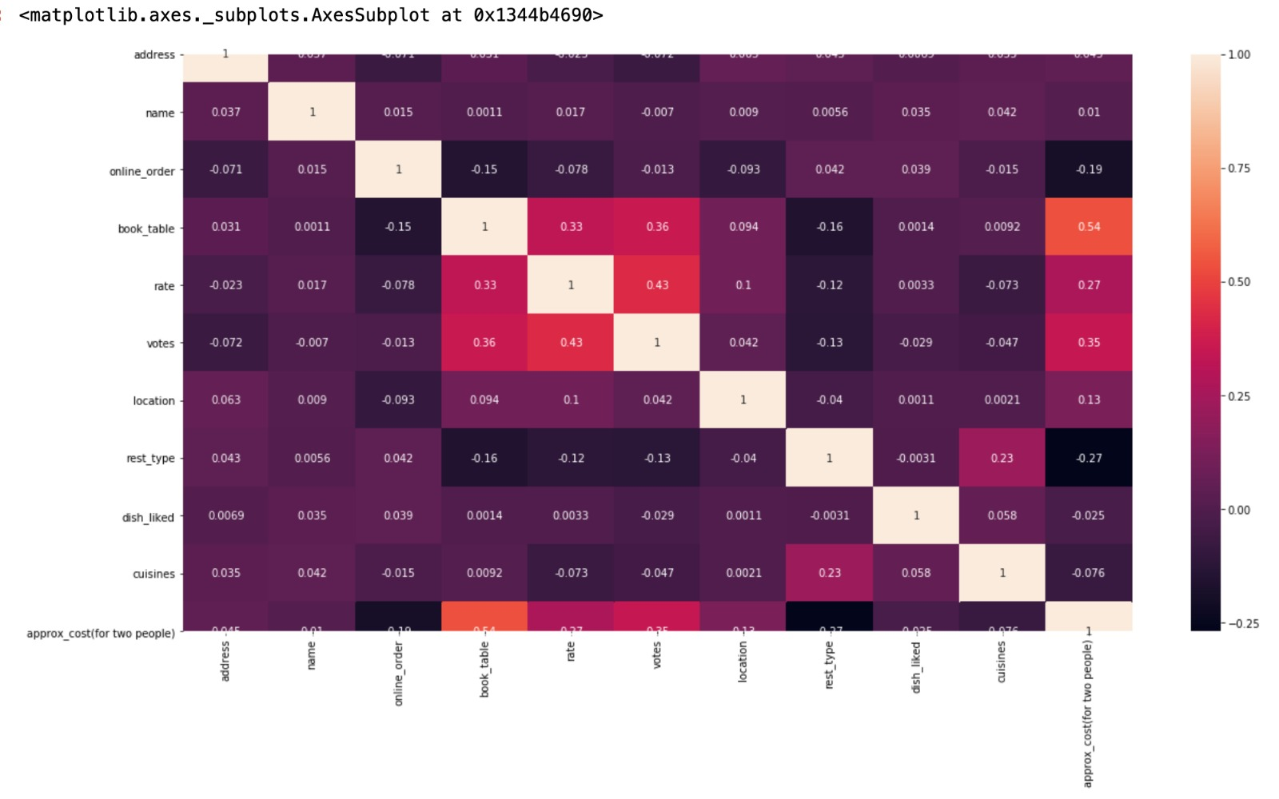
MACHINE LEARNING ON DATASET
With the help of machine learning algorithms, we have predicted the location as our target variable with respect to the rest of the columns
we have used various Python libraries such as sklearn and matplotlib to plot our findings.
To perform machine learning we have used two data sets which is textual data and numeric data.
After Implementing Machine Learning we see that the best accuracy was given by Random Forest

Slide 18
MACHINE LEARNING RESULTS
Numeric Data
Text Data
Algorithm | Accuracy
Decision Tree | 74%
2. Random Forest | 80.01%
Algorithm | Accuracy
1. Random Forest | 81%
2. XG Boost | 84.03%
3. SVM | 92%

Slide 19
CONCLUSION
From the above visualizations we can infer the top 10 best locations, type of restaurant, which dishes and cuisines should an investor select while setting up the restaurants.
With the help of visualization, we have seen the top 10 restaurants in Bangalore area and had a closer look at their cuisines for capturing the attention of people/customers that investor should include some of the dishes which are liked most by these top restaurants.
From our analysis we can help set up a restaurant based on the amount to invest and which location to invest in.
After implementing machine learning algorithms such as Linear Regression, Decision Tree and Random Forest we found that Random Forest algorithm has the highest predicted accuracy of 80%.

